Slide 1



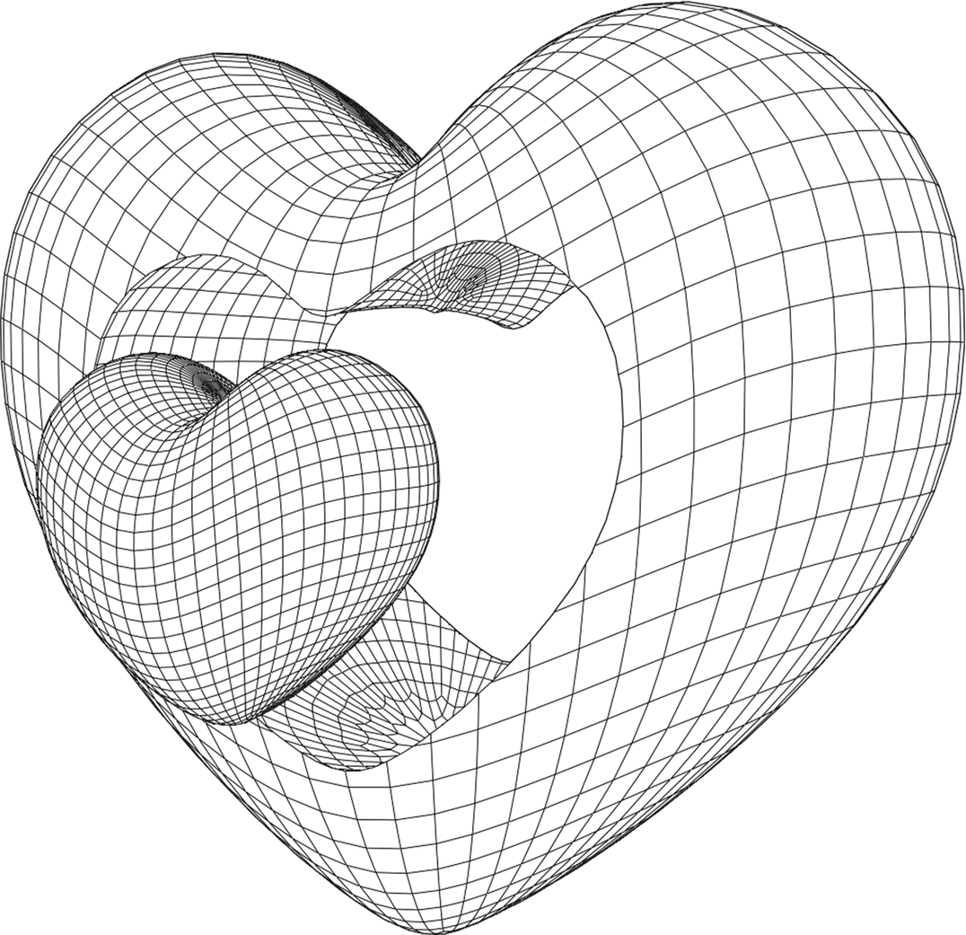
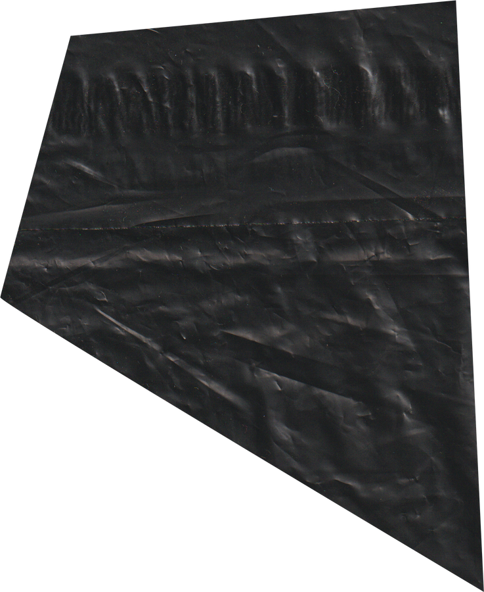

EELU 2024
2D GAME
REPORT

Slide 2
TEAM MEMBERS
1. MOHAMED HESHAM HAFEZ : 20-01268 (TEAM LEADER)
2. Abdelrahman Mahmoud : 20-00375
3. Ali Ashraf Ali : 20-01513
4. Omar Adel El Gazzar : 20-01298
5. Bassem Radi : 20-01151
6. Sherif Mostafa : 20-01363

Slide 3
TABLE OF CONTENT
1
QUICK OVERVIEW
5
GAME-STEPS
2
GAME DESIGN & GAME DEVELOPMENT
6
REFERENCES
3
IMPLEMENTATION
4
2D PLAT-FORMER

Slide 4



GAME GOALS
INTERACT
ENJOYING
MISSIONS

Slide 5
QUICK OVERVIEW
A 2D game features graphics and gameplay in a two-dimensional space, where characters and environments are represented on a flat plane. It typically involves side-scrolling or top-down perspectives. Popular for their simplicity and nostalgic appeal, they are easier to develop compared to 3D games.

Slide 6
GAME DESIGN & GAME DEVLOPMENT
•GAME DESIGN
•DEFINITION: GAME DESIGN INVOLVES CREATING THE CONTENT AND RULES OF A GAME,
INCLUDING THE NARRATIVE, CHARACTERS, MECHANICS, AND GAMEPLAY EXPERIENCE.
•THE GAME DESIGN PROCESS:
•CONCEPTUALIZATION: BRAINSTORMING IDEAS, DEFINING GENRE, TARGET AUDIENCE, PLATFORM
•Game Mechanics: Establishing rules, systems, core mechanics, goals, challenges
•Story and Characters: Creating characters, world-building, dialogue, prototyping
•Iteration based on feedback

Slide 7
GAME DESIGN & GAME DEVLOPMENT
•GAME DEVELOPMENT:
•DEFINITION: GAME DEVELOPMENT IS THE PROCESS OF TURNING A GAME DESIGN
INTO A PLAYABLE PRODUCT,
INVOLVING PROGRAMMING, ART CREATION, SOUND DESIGN, TESTING, AND PUBLISHING.
•THE GAME DEVELOPMENT PROCESS:
•PRE-PRODUCTION: PLANNING, SCHEDULING, DESIGN DOCUMENTS, PROTOTYPES
•Programming: Implementing game mechanics and systems
•Art: Creating visual assets like characters, environments, UI
•Sound: Composing music and sound effects
•Level Design: Creating game levels and environments
•Testing, marketing, releasing the game, post-launch support

Slide 8
2D PLAT-FORMER
•GAME CONCEPT AND DESIGN:
•GAME CONCEPT: 2D PLATFORMER
•Objective: Navigate through levels, overcome obstacles, and defeat enemies
•Multiple challenging levels with increasing difficulty
•CORE GAME MECHANICS:
•PLAYER MOVEMENT: RUN, JUMP, AND PERFORM SPECIAL ACTIONS
•Obstacle Interaction: Spikes, moving platforms, and traps
•Enemy Encounters: Diverse enemy types with unique behaviors
•Collectibles: Coins, power-ups, and keys
•Level Progression: Reach checkpoints and complete objectives

Slide 9
2D PLAT-FORMER
•DEVELOPMENT APPROACH:
•PROGRAMMING LANGUAGE: C#
•Robust integration with Unity
•Efficient implementation of game logic and mechanics
•UNITY GAME ENGINE:
•COMPREHENSIVE TOOLSET FOR 2D GAME DEVELOPMENT
•Scene creation, asset management, and component configuration
•ANIMATION TECHNIQUES:
•CHARACTER ANIMATION: SPRITE ANIMATION AND ANIMATOR CONTROLLER
•Environmental Animation: Parallax scrolling, animated traps, and particle effects

Slide 10
ALOGRITHMS
PATHFINDING ALGORITHMS : ARE AT THE CORE OF ENEMY TRACKING SYSTEMS. THE MOST COMMON ALGORITHMS INCLUDE :
·A* (A-star) Algorithm: A widely used pathfinding and graph traversal algorithm, known for its efficiency and accuracy.
·Dijkstra's Algorithm: An algorithm for finding the shortest paths between nodes in a graph, particularly useful in less complex environments.
·Breadth-First Search (BFS): A simple algorithm for traversing or searching tree or graph data structures, useful in unweighted grid-based maps.

Slide 11
PROGRAMMING AND DEVELOPMENT
•C# LANGUAGE:
•LEVERAGED C#'S OBJECT-ORIENTED FEATURES AND SEAMLESS UNITY INTEGRATION
•Enabled efficient implementation of game logic and mechanics
•UNITY GAME ENGINE:
•UTILIZED UNITY'S COMPREHENSIVE TOOLSET AND 2D-SPECIFIC CAPABILITIES
•Streamlined the overall game development process

Slide 12
PROGRAMMING AND DEVELOPMENT
•CORE GAME MECHANICS:
•RESPONSIVE PLAYER CONTROLS (MOVEMENT, JUMPING)
•Collision detection and physics-based interactions
•Strategically designed levels with obstacles, enemies, and collectibles
•ANIMATION AND VISUALS:
•FLUID CHARACTER ANIMATIONS USING KEYFRAMES AND SPRITE SHEETS
•Dynamic environmental elements, such as moving platforms and particle effects
•USER INTERFACE (UI) DESIGN:
•INTUITIVE AND VISUALLY APPEALING UI ELEMENTS
•Main menu, in-game HUD, and interactive UI components
•SCRIPTING AND GAME LOGIC:
•PLAYER CONTROL SCRIPTS FOR MOVEMENT, JUMPING, AND ANIMATION
•Game manager scripts to handle game states, scoring, and level progression

Slide 13
STEP 1
STEP 2
STEP 3
STEP 4
BRAIN-STORMING
&
PLANNING
GAME-DESIGN
&
GAME-DEVELOPMENT
IMPLEMENTATION
FINAL PRODUCT
GAME STEPS

Slide 14
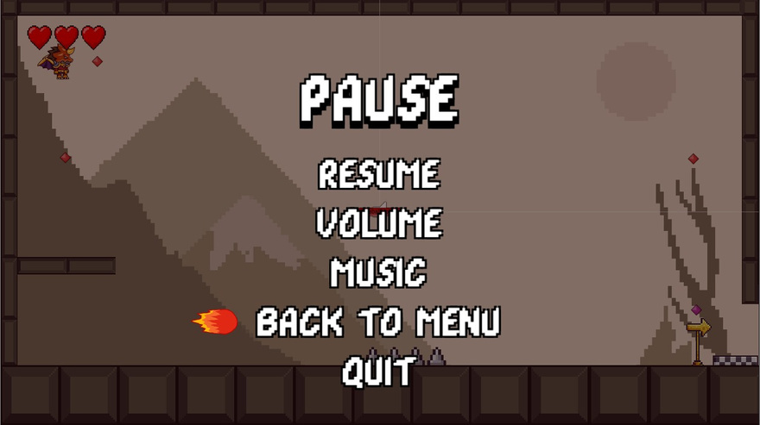
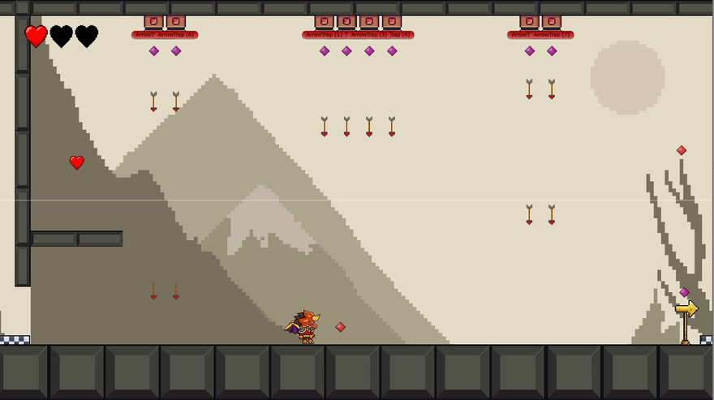
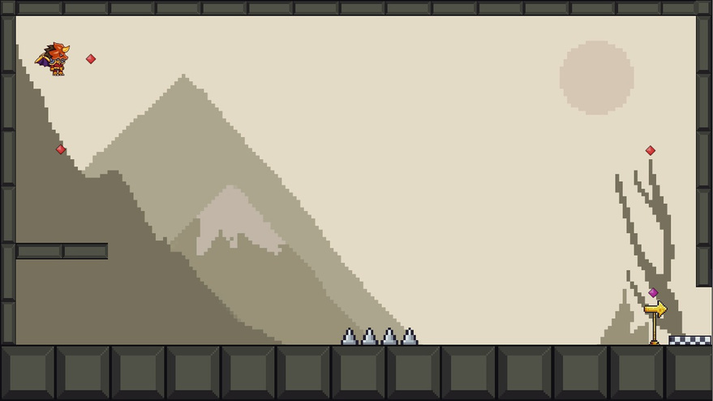
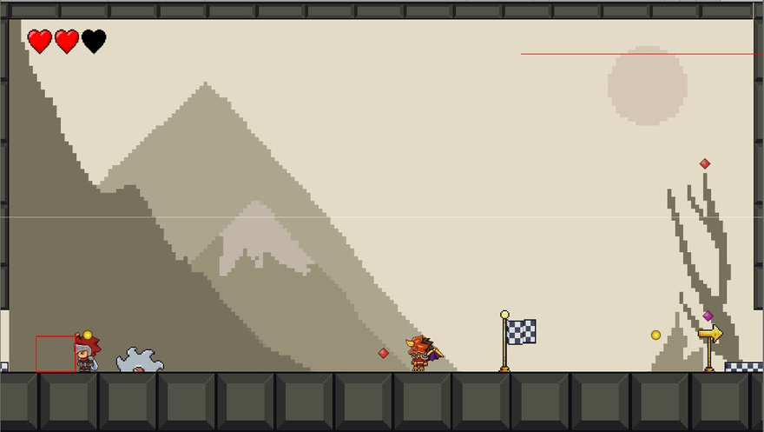
EELU 2024

Slide 15
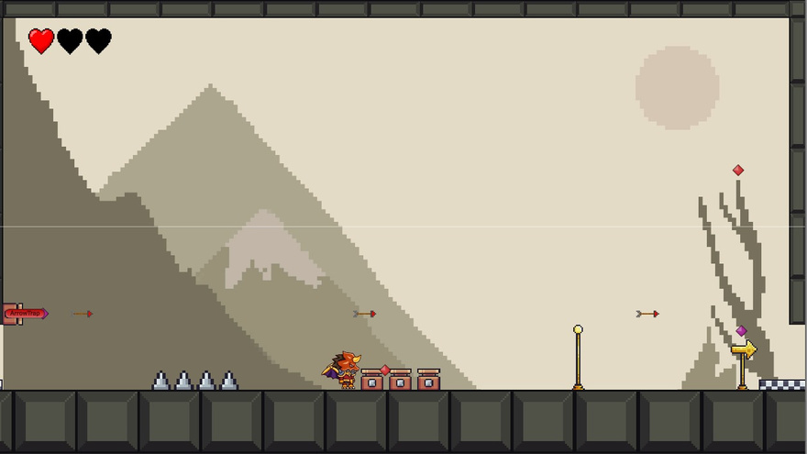
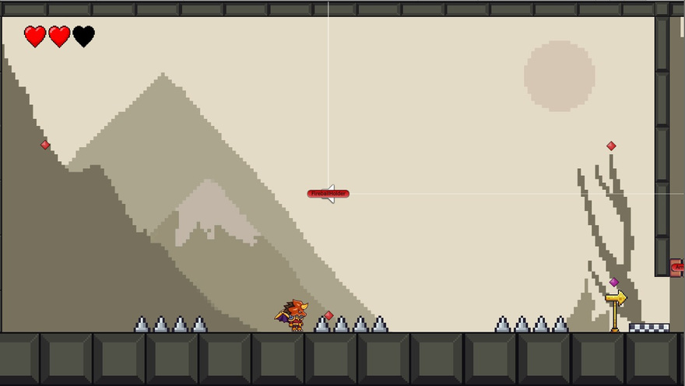
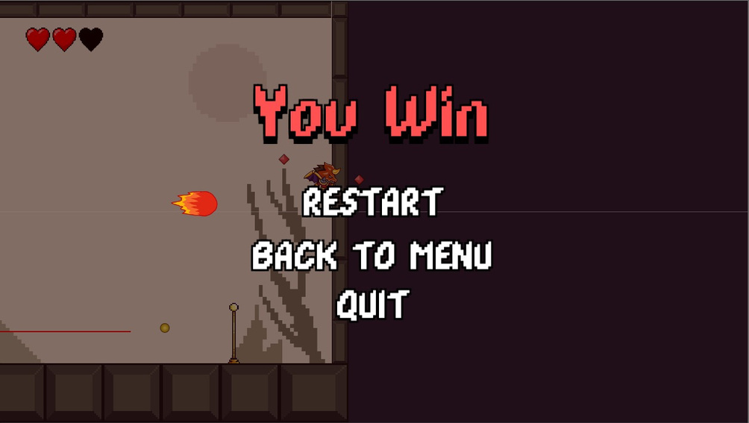
EELU 2024

Slide 16
REFERENCES
1-SUPER MARIO
2-SONIC THE HEDGEHOG SERIES
3.DONKEY KONG COUNTRY SERIES
4.CASTLEVANIA SERIES
5.MEGA MAN SERIES
6.RAYMAN SERIES

Slide 17
EELU 2024
THANK YOU

